Slide 1
Module XIII
Maintenance programme
Franck Lignini
Framatome
franck.lignini@framatome.com

Slide 2
Learning objectives
To understand international requirements and guidance on this matter
Understand the purpose of the maintenance programme
Understand what types of maintenance activities can support the maintenance programme
Notes:
Objective 2 : covers objectives 3, 5, 6, 7 and 9, as listed at the begining of chapter 4.1 of the RCC Book

Slide 3
Contents
International requirements and guidance
Maintenance programmes
  Types of maintenance
  Maintenance organization and administration
  Procedures, records and histories
  Conduct and control of maintenance work
  Maintenance facilities, mock-ups
  Spare parts and materials, procurement, CFSI
Case study
Summary – key points

Slide 4
Introduction
Effective maintenance is essential for the safe operation of a nuclear power plant. It ensures in particular
  reliability and availability of all plant structures, systems and components (SSCs) that have a bearing on safety remain in accordance with the assumptions
  that the safety of the plant is not adversely affected after the commencement of operation
Technical specifications will require the plant to be shut down if certain SSCs important to safety are not returned to service within a certain period of time
Effective maintenance is ensured by comprehensive maintenance programmes, which include mutually supporting elements
Notes:
Effective maintenance as well as surveillance and in-service inspection are essential for the safe operation of a nuclear power plant. They ensure not only that the levels of reliability and availability of all plant structures, systems and components (SSCs) that have a bearing on safety remain in accordance with the assumptions and intent of the design, but also that the safety of the plant is not adversely affected after the recommencement of operation.
To ensure that the overall maintenance is effective, nuclear power plants have comprehensive maintenance programmes, which include mutually supporting elements.

Slide 5
Introduction
Maintenance activities
Maintenance organization
Maintenance facilities and equipement
Conduct and control of mainteance work
Maintenance programme
Material condition
Spare parts and procurement
Outage management
Work procedures and record keeping
Comprehensive
maintenance
programmes
High quality of the material condition ⇒ use of an optimum balance of various types of maintenance
Notes:
Effective maintenance as well as surveillance and in-service inspection are essential for the safe operation of a nuclear power plant. They ensure not only that the levels of reliability and availability of all plant structures, systems and components (SSCs) that have a bearing on safety remain in accordance with the assumptions and intent of the design, but also that the safety of the plant is not adversely affected after the recommencement of operation.
To ensure that the overall maintenance is effective, nuclear power plants have comprehensive maintenance programmes, which include mutually supporting elements.

Slide 6
Requirements and Guidance
Module XIII – Maintenance programme
June 18-22, 2018

Slide 7
General requirements (1)
Maintenance work is properly authorized through the use of procedures and work guidance documents
Work management process supports the completion of maintenance tasks in a safe, timely and productive manner
June 18-22, 2018

Slide 8
General requirements (2)
Efficient and effective coordination is established among different maintenance groups (mechanical, electrical, I&C, civil …), and with operations and supporting groups (fire protection, radiation protection, physical protection, industrial safety, etc.)
Control room operating personnel are directly responsible for safe operation of the plant
  Plant equipment is only removed from service and returned to service with the authorization of the control room
June 18-22, 2018

Slide 9
General requirements (3)
Following maintenance, the equipment is returned to service after testing, if necessary, and its configuration is checked and documented
Maintenance personnel
  is aware of the potential safety consequences of technical and procedural errors while performing maintenance
  goes through specific training to qualify
Move to slide n° 55
June 18-22, 2018

Slide 10
General requirements (4)
Arrangements are established to procure, receive, store and issue spare parts and materials for use in the NPP
The spares have the same technical standards and quality as the installed plant items
June 18-22, 2018

Slide 11
General requirements (5)
All activities of maintenance, testing, surveillance and inspection are recorded, stored and analyzed
If any abnormal event happens, the operating organization revalidates the safety functions and the structural and functional integrity of any SSC that may have been challenged by the event
Corrective actions include in-service inspection, testing and maintenance, as appropriate
June 18-22, 2018

Slide 12
General requirements – Outage (1)
Outages are used to perform maintenance, testing, surveillance and inspection activities that cannot be performed when the plant is in power operation
  Nuclear safety is paramount
  Effective implementation and control of all activities during planned and forced outages
    Extensive preparation
    Interface between maintenance and other groups are clearly defined
    Tracking system is used to monitor the status and ensure controlled execution of outage activities
June 18-22, 2018

Slide 13
General requirements – Outage (2)
Outages activites are also performed by contractors and have to be supervised by means of established management systems
  Training and qualification of contractor personnel, radiation protection, familiarity with and adherence to procedures, understanding of plant systems, and applicable administrative procedures for both normal operation and emergency conditions
  The operating organization is reponsible for plant safety and for ensuring that the contractor’s work is of the required quality
ALARA principle and waste reduction programmes are taken into consideration
  High dose work is planned and co-ordinated so as to mininimize doses
June 18-22, 2018

Slide 14
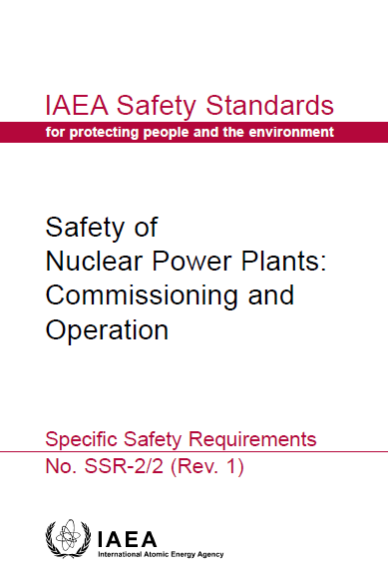
SSR-2/2 (rev 1)
Provides requirements for commissioning and operation
related to the topic of this module :
Requirement 31: Maintenance, testing, surveillance and inspection programmes
The operating organization shall ensure that effective programmes for maintenance, testing, surveillance and inspection are established and implemented.
Requirement 32: Outage management
The operating organization shall establish and implement arrangements to ensure the effective performance, planning and control of work activities during outages.
In addition to SSR-2/2, several Safety Standards apply to maintenance programmes …
June 18-22, 2018

Slide 15
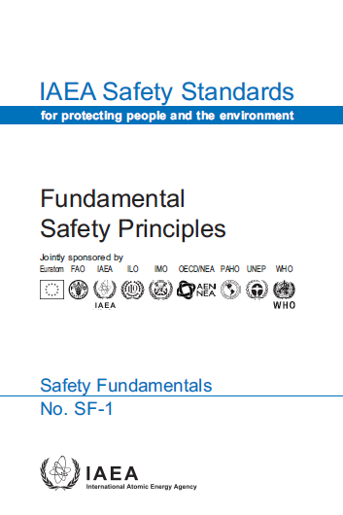
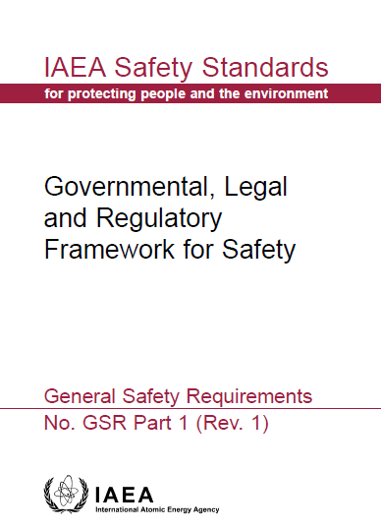
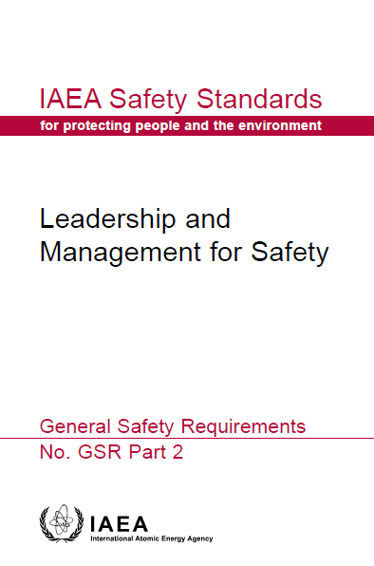
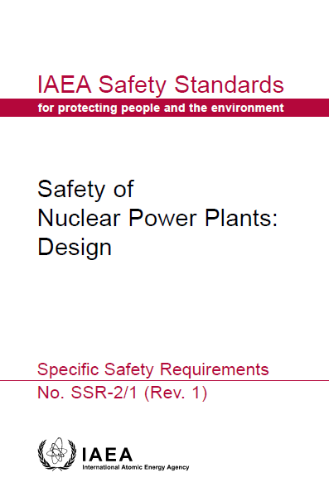
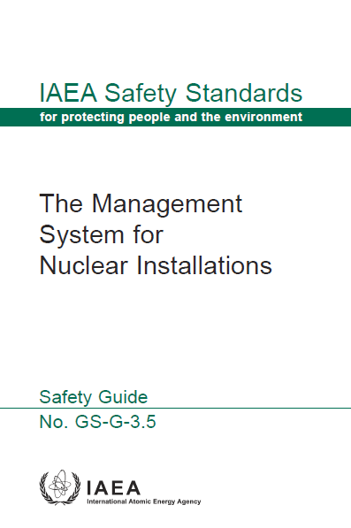
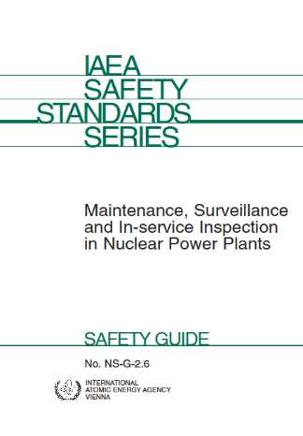
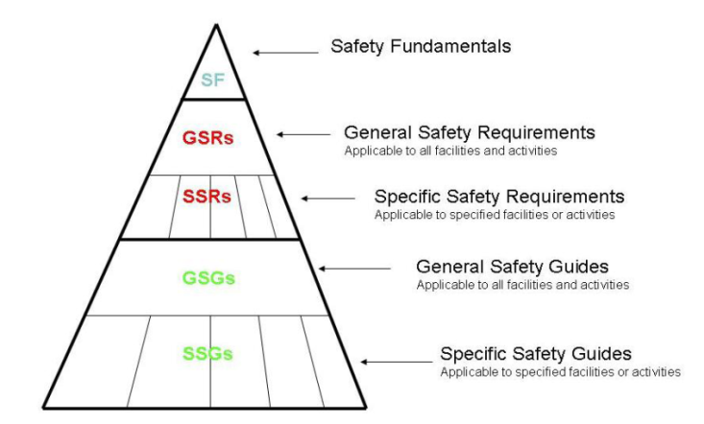
Some IAEA Safety Standards applying to Maintenance programmes for NPPs
(#)
=> DS497
Notes:
Safety Guide NS-G-2.3 provides guidance and recommendations on controlling the activities related to modifications at NPPs designed to reduce risk, ensure that configuration control is maintained and ensure that the modified configuration satisfies licensing requirements. Guidance on changes in management is intended to ensure that such changes do not compromise the safety of the plant. Recommendations are provided on:
The roles and responsibilities of the operating organization, the regulatory body and other organizations, such as contractors;
Modifications relating to the plant configuration, including categorization by safety significance, safety assessment, review and design considerations, modifications to OLCs, modifications to operating procedures and modifications to computer-based systems, and their implementation;
Modifications to management systems, including organizational changes and their implementation, operation management and safety assessment tools and processes; and
Quality assurance, training and management of documentation.
Specific Safety Requirements SSR-2/2 “Safety of Nuclear Power Plants: Commissioning and Operation” provides requirements for commissioning and operation related to the topic of this module such as:
Requirement 10: Control of plant configuration; Requirement 11: Management of modifications;
Requirement 12: Periodic safety review; Requirement 13: Equipment qualification;
Requirement 14: Ageing management; Requirement 15: Records and reports; and
Requirement 16: Programme for long term operation.
Safety Guide SSG-25, Periodic Safety Review for Nuclear Power Plants provides guidance and recommendations for periodic safety reviews of nuclear power plants, but could be applied with a suitable graded approach to research reactors and other nuclear installations. Routine reviews of NPP operations and special reviews following events of safety significance are the primary means of safety verification of operating installations. Some Member States have initiated a process termed the periodic safety review to assess the cumulative effects of plant ageing and plant modifications, considering operating experience, technical developments and siting considerations.
The reviews include an assessment of plant design and operation in the light of current safety standards and practices. The PSRs are complementary to routine and special reviews and do not replace them. Periodic safety reviews may reveal the need for plant modifications. Recommendations are provided on:
The strategy for a PSR; Safety factors in a PSR; Roles and responsibilities in a PSR;
The procedure for conducting a PSR; The basis for acceptability of continued plant operation and
Post-review activities.
Safety Guide NS-G-2.12 (Ageing Management for Nuclear Power Plants) provides recommendations for managing the ageing of SSCs important for safety in nuclear power plants, including recommendations on key elements of effective ageing management. The Safety Guide is intended for use by operators in establishing, implementing and improving systematic ageing management programmes for nuclear power plants. This Safety Guide may be used by regulators in preparing regulatory standards and guides, and in verifying that ageing in nuclear power plants is being effectively managed. This Safety Guide deals with the establishment, implementation and improvement of ageing management programmes for SSCs important to safety in nuclear power plants. The Safety Guide mainly focuses on managing the physical ageing of SSCs important to safety. It also provides recommendations on safety aspects of managing obsolescence and on the application of ageing management for long term operation. Issues relating to staff ageing and knowledge management are outside the scope of this Safety Guide.

Slide 16
Maintenance programmes – Types of maintenance
Module XIII – Maintenance programme
June 18-22, 2018

Slide 17
Maintenance programmes – introduction (1)
Recall that the Maintenance Programmes ensure that safety significant equipment and components provide the required functionality to enable safe and reliable power production.
  Optimize safe and reliable performance of plant systems and components over the lifetime of the plant.
Maintenance Programmes are prepared for those SSCs which are important to safety.
  The operational limits and conditions and any other applicable regulatory requirements are taken into account
  Appropriate reports and records are kept
  Maintenance programmes are periodically re-evaluated and improved as necessary
June 18-22, 2018
Notes:
The SALTO peer review is based on Specific Safety Requirements for NPP operation SSR-2/2 and follows the IAEA Safety Report on Safe Long Term Operation of Nuclear Power Plants that addresses the following areas:
LTO feasibility (feasibility studies, preconditions for LTO, plant programmes);
Scoping and screening of systems, structures, and components (SSCs);
Assessment and management of SSCs for ageing degradation for LTO;
Time limited ageing analysis (TLAA, also termed safety analysis that uses time-limited assumptions);
Documentation.
The SALTO peer review is conducted by a team of international experts with direct experience in the areas of the review. Judgements of performance are made on the basis of IAEA safety standards and other IAEA publications, and of the combined expertise of the international review team. The review is neither a regulatory inspection nor is it an audit against national codes and standards. The review is a technical exchange of experiences and practices at the working level aimed at strengthening the programmes, procedures and practices being followed.

Slide 18
Maintenance programmes – introduction (2)
The maintenance programme covers all the preventive and corrective measures, both administrative and technical, necessary:
  to identify, prevent, and/or mitigate degradation of a functioning SSC or
  to restore the design functions of a failed SSC to an acceptable level
Maintenance activities include:
  servicing, overhaul, repair, and replacement of parts
  may include testing, calibration, and in-service inspection
Maintenance activities contribute to the Ageing Management programme
June 18-22, 2018
Notes:
The SALTO peer review is based on Specific Safety Requirements for NPP operation SSR-2/2 and follows the IAEA Safety Report on Safe Long Term Operation of Nuclear Power Plants that addresses the following areas:
LTO feasibility (feasibility studies, preconditions for LTO, plant programmes);
Scoping and screening of systems, structures, and components (SSCs);
Assessment and management of SSCs for ageing degradation for LTO;
Time limited ageing analysis (TLAA, also termed safety analysis that uses time-limited assumptions);
Documentation.
The SALTO peer review is conducted by a team of international experts with direct experience in the areas of the review. Judgements of performance are made on the basis of IAEA safety standards and other IAEA publications, and of the combined expertise of the international review team. The review is neither a regulatory inspection nor is it an audit against national codes and standards. The review is a technical exchange of experiences and practices at the working level aimed at strengthening the programmes, procedures and practices being followed.

Slide 19
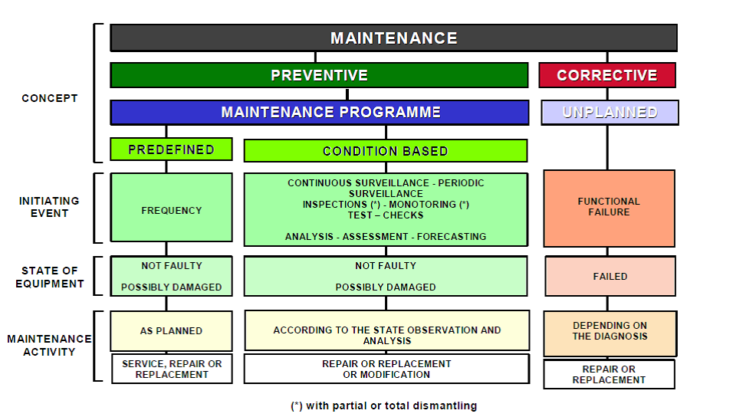
Types of maintenance
Two broad categories of maintenance activities :
Preventive
Corrective
June 18-22, 2018

Slide 20
Preventive maintenance
Preventive maintenance
Periodic maintenance activities
Planned maintenance activities
Predictive maintenance activities
June 18-22, 2018

Slide 21
Frequency of preventive maintenance activities
The frequency of maintenance activities is determined by the SSCs’ :
Relative importance to safety
Inherent reliability
Assessed potential for degradation during operation and ageing characteristics
Operational experience
Manufacturer’s recommendations
June 18-22, 2018
Notes:
The maintenance programmes include programmes for in-service inspection, plant ageing and predictive, preventive and corrective maintenance, which together optimize safe and reliable performance of plant systems and components over the lifetime of the plant. These programmes are fully integrated with plant operation and modification activities. They are routinely reviewed and updated, as required, to take into account on site and off site operating experience and modifications to the plant or its operating regime.
The frequency of preventive and predictive maintenance, testing, surveillance and inspection of individual structures, systems, and components is determined by:
Their relative importance to safety,
Inherent reliability,
Assessed potential for degradation during operation and ageing characteristics,
Operational experience,
Manufacturer’s recommendations.

Slide 22
Preventive maintenance
Periodic (or time-based) maintenance
  Routine activities which include external inspections, alignments or calibrations, internal inspections, overhauls, and replacement of components or equipments
Predictive (or condition-based) maintenance
  Continuous or periodic monitoring and diagnosis
Planned maintenance activities
  Initiated on the basis of results of predictive or periodic maintenance
  Performed prior to unacceptable degradation or equipment failure
Move to slide n° 58
June 18-22, 2018
Notes:
Periodic or time-based maintenance activities are accomplished on a routine basis and include any combination of external inspections, alignments or calibrations, internal inspections, overhauls, and replacements of components or equipment.
Predictive or condition-based maintenance involves continuous or periodic monitoring and diagnosis in order to predict equipment failure. Not all equipment conditions and failure modes can be monitored, however; predictive maintenance should therefore be selectively applied where appropriate. Predictive techniques includes condition monitoring, reliability centred maintenance and similar techniques.
Planned maintenance activities are performed prior to unacceptable degradation or equipment failure and are initiated on the basis of the results of predictive or periodic maintenance, vendor recommendations or experience.

Slide 23
Corrective maintenance
Actions to repair, overhaul or replace in order to restore the capability of a failed SSC to perform its defined function
June 18-22, 2018
Notes:
Periodic or time-based maintenance activities are accomplished on a routine basis and include any combination of external inspections, alignments or calibrations, internal inspections, overhauls, and replacements of components or equipment.
Predictive or condition-based maintenance involves continuous or periodic monitoring and diagnosis in order to predict equipment failure. Not all equipment conditions and failure modes can be monitored, however; predictive maintenance should therefore be selectively applied where appropriate. Predictive techniques includes condition monitoring, reliability centred maintenance and similar techniques.
Planned maintenance activities are performed prior to unacceptable degradation or equipment failure and are initiated on the basis of the results of predictive or periodic maintenance, vendor recommendations or experience.

Slide 24
Maintenance organization and administration
The operating organization has the ultimate responsibility for preparing and executing adequate maintenance
  Assign responsibilities and authority
  Establish maintenance entity
    Typically divided into mechanical, electrical and I&C units
The organization, staffing and resources of the maintenance entity and responsibilities are described in writing
  Must be understood by all
Effective coordination among different maintenance units is necessary
Move to case study
slide n° 59
June 18-22, 2018

Slide 25
Maintenance organization and administration
Staff can be supplemented as necessary.
The organization, qualifications, and number of maintenance personnel must be sufficient during operations or outages.
  Outage work may be outsourced to contractors.
The goals and objectives of the maintenance entity are defined within the plant policies and objectives.
June 18-22, 2018

Slide 26
Maintenance organization and administration
Clearly allocates responsibilities to accountable identified individuals.
Evaluates its performance through self-assessment
Takes self-initiated corrective actions for performance enhancements.
Personal integrity and professionalism are a central part of every job.
Managers serve as an example through leadership.
June 18-22, 2018

Slide 27
Procedures, records and histories
Maintenance procedures and other work-related documents ensure that maintenance is performed safely and efficiently.
Maintenance instructions are compiled in accordance with quality assurance requirements.
Maintenance history is used to support:
  maintenance activities,
  upgrade maintenance programmes,
  optimise equipment performance and
  improve equipment reliability.
June 18-22, 2018

Slide 28
Maintenance Procedures and Records (1)
The preparation, review, approval, and revision of procedures and other work related documents are properly supervised.
Procedures and work instructions are:
  technically accurate,
  easy to understand,
  up to date, and
  readily available.
June 18-22, 2018
Notes:
Appropriate procedural controls and safety instructions are specified for maintenance activities. The preparation, review, approval and revision of procedures and other work related documents are properly supervised. Documents used in lieu of procedures (such as excerpts from vendor manuals) receive the same review and approval as procedures.
Procedures are normally prepared in co-operation with the designers, the suppliers of plant and equipment, and the personnel conducting activities for quality assurance, radiation protection and technical support.
Procedures and work instructions used to perform maintenance activities are technically accurate, easy to understand, up to date and readily available to the users.

Slide 29
Maintenance Procedures and Records (2)
Normally prepared in co-operation with the equipment manufacturers, vendor suppliers, and the personnel conducting the activities
Procedures are periodically reviewed for technical accuracy, human factors, and the inclusion of in-house and industry operating experience.
Changes are regulated, including an appropriate review and approval.
June 18-22, 2018
Notes:
Procedures are normally prepared in co-operation with the designers, the suppliers of plant and equipment, and the personnel conducting activities for quality assurance, radiation protection and technical support.
Procedures and work instructions used to perform maintenance activities are technically accurate, easy to understand, up to date and readily available to the users.
An effective programme exists to review procedures periodically for technical accuracy, human factors, and the inclusion of in-house and industry operating experience. Temporary changes to procedures are sufficiently regulated, including an appropriate review and approval.

Slide 30
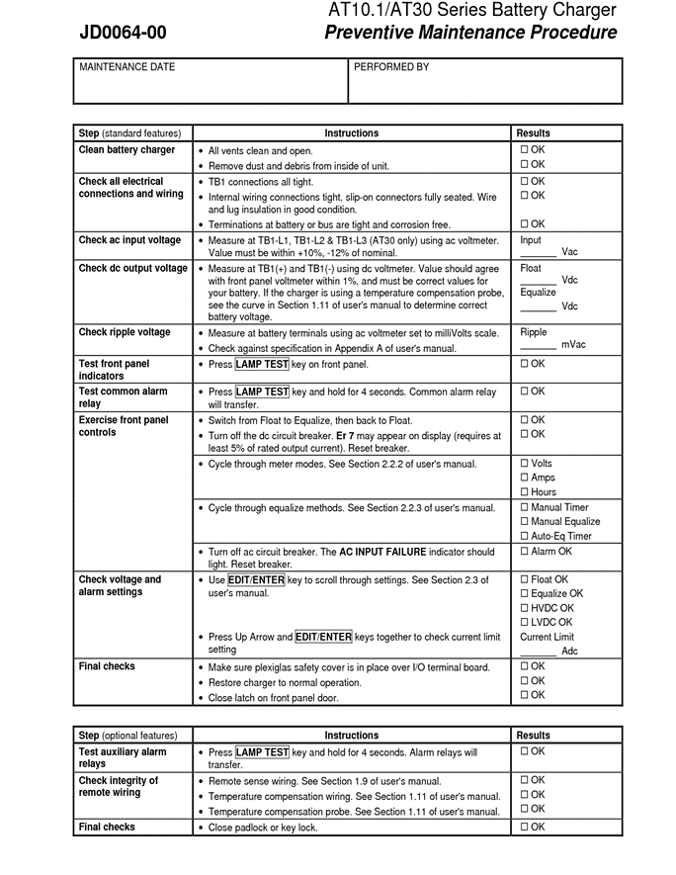
June 18-22, 2018
Notes:
Appropriate procedural controls and safety instructions are specified for maintenance activities. The preparation, review, approval and revision of procedures and other work related documents are properly supervised. Documents used in lieu of procedures (such as excerpts from vendor manuals) receive the same review and approval as procedures.
Procedures are normally prepared in co-operation with the designers, the suppliers of plant and equipment, and the personnel conducting activities for quality assurance, radiation protection and technical support.
Procedures and work instructions used to perform maintenance activities are technically accurate, easy to understand, up to date and readily available to the users.

Slide 31
June 18-22, 2018
Notes:
Appropriate procedural controls and safety instructions are specified for maintenance activities. The preparation, review, approval and revision of procedures and other work related documents are properly supervised. Documents used in lieu of procedures (such as excerpts from vendor manuals) receive the same review and approval as procedures.
Procedures are normally prepared in co-operation with the designers, the suppliers of plant and equipment, and the personnel conducting activities for quality assurance, radiation protection and technical support.
Procedures and work instructions used to perform maintenance activities are technically accurate, easy to understand, up to date and readily available to the users.

Slide 32
Maintenance History
Maintained for systems and equipment important to plant safety and reliability.
Periodically reviewed and analysed:
  to identify adverse equipment performance trends and persistent maintenance problems,
  to assess their impact on system reliability, and
  to determine root causes.
The results are used to improve corrective and preventive maintenance on all affected equipment.
June 18-22, 2018
Notes:
Adequate history records are maintained for systems and equipment important to plant safety and reliability.
The documentation of maintenance work and inspection/test results must be complete. The maintenance history records are retrievable and secure.
Maintenance histories are periodically reviewed and analysed to identify adverse equipment performance trends and persistent maintenance problems, to assess their impact on system reliability, and to determine root causes. The resulting information is used to improve corrective and preventive maintenance on all affected equipment. Maintenance is adequately documented and the root causes are properly identified.

Slide 33
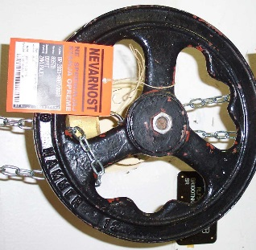
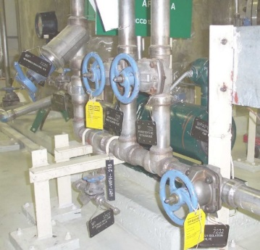
Conduct of Maintenance (1)
Maintenance is conducted in a safe and efficient manner to support plant operation.
Programme elements:
  Work is started only after obtaining necessary authorizations (work permit, fire permit, radiological zones access permit, etc.).
  Clearance (tagging) system is used and
  understood by all maintenance personnel.
  Foreign material exclusion procedures
  are followed.
  Adequate resources are available (during day and night shifts.
  Pre-job briefings.
June 18-22, 2018
Notes:
Maintenance is conducted in a safe and efficient manner to support plant operation. Personnel exhibit professionalism and competence, which results in quality workmanship in performing assigned tasks.
Maintenance personnel are attentive to identifying and responsive to correcting plant deficiencies with the goal of maintaining equipment and systems in operation and in optimum material condition.
Maintenance work is started only after obtaining necessary authorizations (work permit, fire permit, specific zones access permit, etc.), and is performed by qualified personnel. Adequate resources are available for maintenance during day and night shifts. Procedures which include hold points for independent quality control inspection are followed, and procedural problems are promptly resolved.
Managers and supervisors routinely observe maintenance activities and ensure adherence to station policies and procedures.

Slide 34
Conduct of Maintenance (2)
Programme elements (cont):
  Contractors and other non-utility personnel:
    use same control procedures,
    apply the same standards,
    are supervised,
    trained and qualified to the same standards as plant personnel.
  Procedures with hold points have independent quality control inspection.
  Post-maintenance testing is performed, documented, and reviewed.
  Equipment is returned to service.
  Managers and supervisors routinely observe maintenance activities.
June 18-22, 2018
Notes:
The work groups are instructed on specific jobs, are knowledgeable of any special requirements, and are aware of the impact of their jobs on nuclear safety.
Contractors and other non-utility personnel conducting plant maintenance operate under the same control procedures and to the same standards as plant maintenance personnel and are properly supervised. Contractors working on safety-related SSCs are selected and qualified by the plant, and trained to the same standards as plant personnel.
Appropriate personnel (e.g. operations, engineering and maintenance) perform post-maintenance testing, document and review the results, and return equipment to service only when it is fully ready.
An adequate clearance (tagging) system is in use for the protection of equipment and the safety of personnel during maintenance. Personnel understand and use the clearance system correctly and are safety conscious in the conduct of their work and use safety equipment as appropriate.

Slide 35
Work Planning and Control (1)
  The work planning system maintains a high availability and reliability of important SSCs.
  The comprehensive work control system includes authorizations, permits, and certificates necessary to:
    help ensure safety in the work area and
    prevent maintenance activities from affecting other safety relevant areas.
Work planning and control ensures activities are:
  evaluated for risk and safety,
  properly planned, scheduled, and authorized,
  carried out in accordance with appropriate procedures and
  can be completed in a timely manner.
June 18-22, 2018
Notes:
A comprehensive work planning and control system applying the defence in depth principle is implemented so that work activities can be properly authorized, scheduled and carried out by either plant personnel or contractors, in accordance with appropriate procedures, and can be completed in a timely manner. The work planning system maintains a high availability and reliability of important plant SSCs.
The comprehensive work control system includes any authorizations, permits and certificates necessary to help ensure safety in the work area and to prevent maintenance activities from affecting other safety relevant areas. The following specific matters are considered in the work control system:
work order authorizations;
equipment isolation, work permits and tagging;
radiation work permits;
industrial safety precautions;
drainage facilities and ventilation;
fire hazard control;
electrical and mechanical isolation devices;
control of plant modifications.

Slide 36
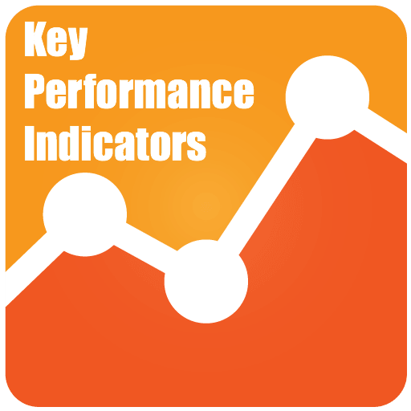
Work Planning and Control (2)
The effectiveness of the work control process is monitored via indicators:
  repeat work orders
  dose rates (individual & collective)
  backlog of work orders
  interference with plant operations.
If the effectiveness of the work process is reduced, corrective action are taken.
The work control process has:
  Operational feedback system
  Systematic analysis of rework / repetitive failures.
June 18-22, 2018
Notes:
The effectiveness of the work control process is monitored via appropriate indicators (such as repeated work orders, individual and collective radiation doses, the backlog of pending work orders, interference with operations) and corrective action taken when required. Plant defects should be tracked to completion and records kept of work performed. The work control process contains an effective operational feedback system and a systematic analysis of root causes of rework or repetitive failures.
The work control system ensures that plant equipment is released from service for maintenance, testing, surveillance and in-service inspection only upon authorization of designated operating personnel and in compliance with the operational limits and conditions. It also ensures that, following maintenance, testing, surveillance and in-service inspection, the plant is returned to service only upon completion of a documented check of its configuration and, where appropriate, of a functional test.
PIs are established and periodically reported, including:
Outstanding backlogs; Non-proceduralized practices or ‘workarounds’;
Control room instruments out of service; Rework;
Percentage of spare parts which are available, or as expected, or on demand;
Average time for corrective maintenance actions;
Frequency of human errors;
Completion of training to agreed time-scales;
Minor injuries and near misses
an increasing trend frequently represent precursors to more serious accidents.
Housekeeping concerns.

Slide 37
Work Planning and Control (3)
The work control process has:
  Operational feedback system
  Systematic analysis of rework / repetitive failures.
Work scheduling allocates parts, materials, resources, and expertise for completion of the preventive and corrective programmes.
The work planning system provides management with an accurate status of:
  remaining work
  planned and completed activities.
June 18-22, 2018
Notes:
Regular maintenance and operations staff meetings are held concerning maintenance priorities and work scheduling. The system prioritizes work, therefore the most important work is done before more routine work items and the backlog of work is effectively managed. Scheduling and co-ordination of work avoids unnecessary removal of systems and equipment from service, and uses manpower efficiently.
Work scheduling allocates parts, materials, resources and expertise at the appropriate time for completion of the preventive and corrective programmes. Post-maintenance testing requirements are clearly defined and acceptance criteria are adequately specified.
Radiation dose accumulation is effectively monitored during performance of high-dose work, and appropriate dose controls are in place.
The work planning system provides management with an accurate status of outstanding maintenance work, planned maintenance and completed maintenance. Temporary repairs are minimized and replaced by permanent repairs when conditions permit. Temporary repairs are well identified and documented.

Slide 38
Training - Qualification
Purpose: to develop and maintain knowledge and skills to effectively perform maintenance activities. Includes:
  Safety risks involved in maintenance work,
  Methods to minimize these risks.
Operating experience is analysed for maintenance lessons to be learned.
Maintenance management:
  Actively involved in design, conduct of and evaluation of training.
  Regularly meet with training management
June 18-22, 2018

Slide 39
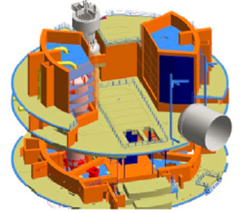
Maintenance facilities
The working facilities provide sufficient space and equipment to perform maintenance activities efficiently and effectively.
  The size and arrangement of maintenance facilities - including around the equipment to be maintained - promotes the safe and efficient completion of work.
  Facilities are provided for work
  on both contaminated and
  uncontaminated equipment.
Examples of maintenance facilities:
  Workshop facilities,
  Facilities for maintenance on radioactive items,
  Decontamination facilities,
  Mock-ups.
In situ maintenance is considered at design stage in the layout of new reactors
June 18-22, 2018

Slide 40
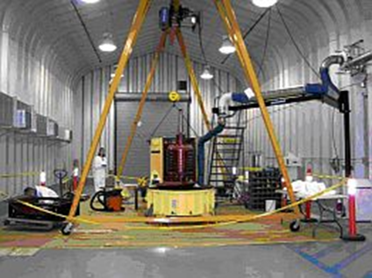
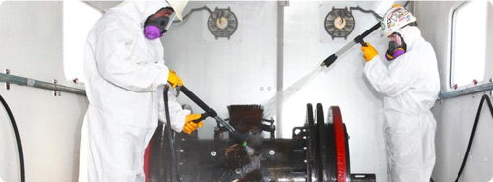
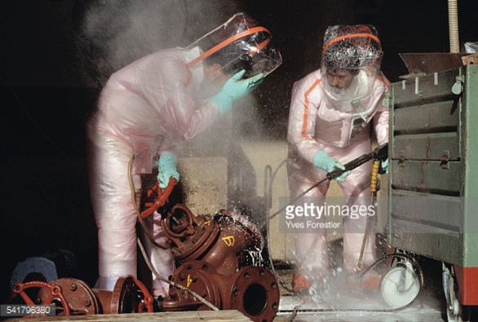
Facilities for maintenance on contaminated or irradiated items
Provided for maintenance on contaminated items:
  to keep radiation doses to individuals as low as reasonably achievable and
  to prevent the spread of contamination.
  Workshops located within the radiologically controlled area.
June 18-22, 2018

Slide 41
Mock-ups
Used to reduce radiation exposure and avoid errors.
  for an unusual or specialized task;
  preparation and validation of procedures,
  gathering of experience with tools and protective equipment;
  development and improvement of tools and equipment;
  training and qualification of personnel for specific work
  confirmation of estimates for work durations.
June 18-22, 2018

Slide 42
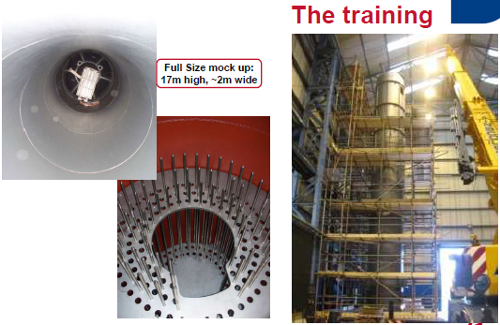
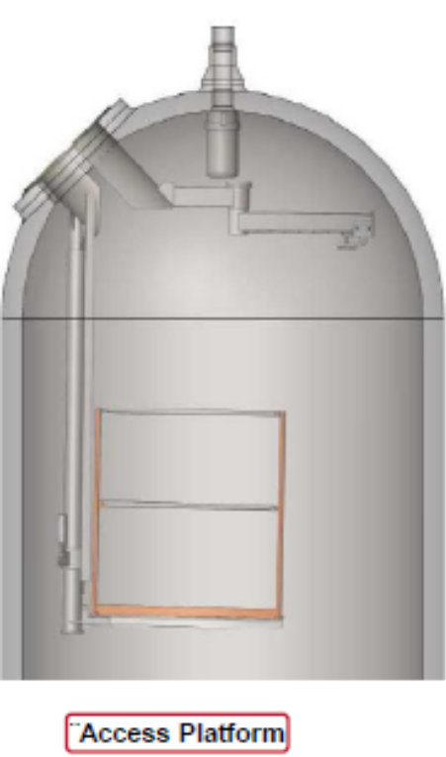
Example : Sizewell B (United Kingdom)
Pressurizer repair operation
June 18-22, 2018

Slide 43
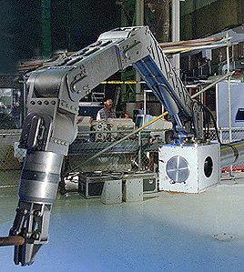
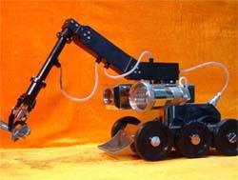
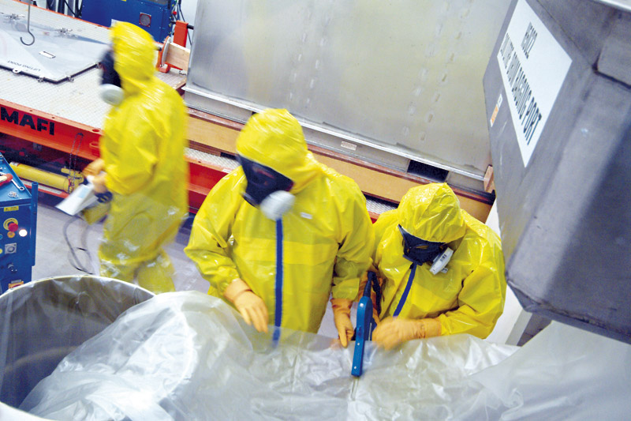
Maintenance tools and equipment
Contaminated tools and equipment are adequately marked and segregated − prevents the spread of contamination.
Measuring and test equipment is calibrated and tested adequately to ensure accuracy and traceability.
Use of special equipment where this could reduce exposure or enhance safety, and provides adequate training in its use.
Remote controlled tools are used to minimize radiation exposures
remote handling manipulators
protective clothing
June 18-22, 2018

Slide 44
Spare parts and materials
Maintenance organization must be able to provide the parts and materials when needed.
Parts/materials must meet established quality or design requirements consistent with their importance to safety.
Maintenance organization must procure, receive, store, and issue materials, spare parts and components for use in the plant.
June 18-22, 2018

Slide 45
Procurement
Procurement specifications are clear and unambiguous.
  include current technical and QA requirements
  include requirements regarding substitutions of materials or components.
Parts/materials only obtained from qualified suppliers.
Parts/materials must have the necessary certificates.
Receipt inspections are performed to ensure compliance with design, procurement specifications and QA requirements.
Must have process for certifying commercial-grade material.
Materials and parts needed for outages are ordered well in advance to support the outage schedule.
June 18-22, 2018

Slide 46
Counterfeit, Fraudulent and Suspect Items
Counterfeit, fraudulent, and suspect items (CFSI) represent a very real risk to nuclear safety.
Important that regulators, licensees, and their suppliers take measures to protect and assure the integrity of the facility.
Resources required to prevent CFSI from entering the facility, and to identify and dispose CFSI already in the facility.
Specific training is undertaken for:
  The detection of installed CFSI.
  Identifying CFSI during receipt and inspection.
  Using CFSI information within the procurement process.
  Including the potential for CFSI as a factor in component failures.
June 18-22, 2018

Slide 47
Counterfeit, Fraudulent and Suspect Items
Facilities most effective in detecting CFSI have common characteristics:
An engineering department responsible for the tracking and evaluation of CFSI.
Engineering staff involvement in procurement and product acceptance.
Effective source inspection, receipt inspection, and testing programmes.
Thorough, engineering-based programmes for review, testing, and dedication of commercial-grade products for suitability in safety systems.
June 18-22, 2018

Slide 48
Example of CSFI
2012 –Korea's Nuclear Safety and Security Commission began investigating incidents in which Korea Hydro and Nuclear Power (KHNP) had allegedly been supplied with falsely certified electrical cable.
Investigations revealed that defective cable had been used in four operating and construction units in South Korea.
KHNP shut down and delayed start-up of the affected units in order to replace the cable.
June 18-22, 2018

Slide 49
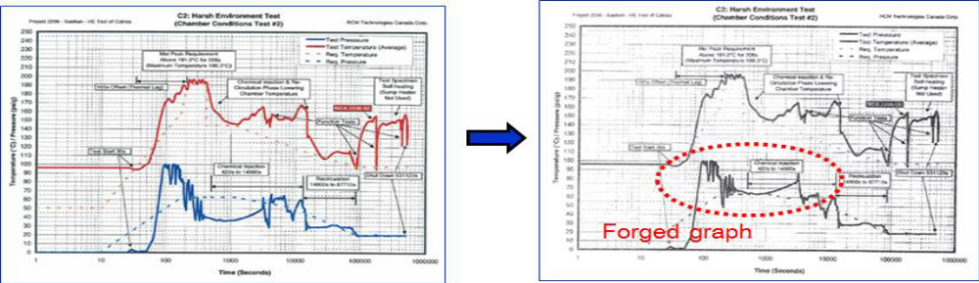
Example of CSFI
2012 –Korea's Nuclear Safety and Security Commission began investigating incidents in which Korea Hydro and Nuclear Power (KHNP) had allegedly been supplied with falsely certified electrical cable.
Investigations revealed that defective cable had been used in four operating and construction units in South Korea.
KHNP shut down and delayed start-up of the affected units in order to replace the cable.
June 18-22, 2018

Slide 50
Summary – Key Points
Module XII – Plant renewals, modifications and upgrades, ageing
June 18-22, 2018

Slide 51
Summary - Key points
Maintenance Programmes ensure that safety significant equipment and components provide the required functionality to enable safe and reliable power production
The maintenance programme covers all the preventive and corrective measures, both administrative and technical, necessary:
  to identify, prevent, and/or mitigate degradation of a functioning SSC or
  to restore the design functions of a failed SSC to an acceptable level
Maintenance activities are conducted under the responsibility of the operating organization. The maintenance entity of the operating organization and the contractors have to be supervised by means of established integrated management system giving overriding priority to nuclear safety.
Module XII – Plant renewals, modifications and upgrades, ageing
June 18-22, 2018

Slide 52
List of abbreviations
ALARA: As Low As Reasonably Achievable
CFSI: Counterfeit, Fraudulent and Suspect Item
CVCS: Chemical, Volumetric Control System
I&C: Instrumentation and Control
NPP: Nuclear power plant
QA: Quality Assurance
SSCs: Structures, systems and components
Module XII – Plant renewals, modifications and upgrades, ageing
June 18-22, 2018

Slide 53
References
[1] SF-1 : Fundamental Safety Principles
[2] GSR Part 1 rev. 1 : Governmental, legal and regulatory framework for safety
[3] GSR Part 2 : Leadership and management for safety
[4] SSR-2/1 rev.1 : Safety of nuclear power plants : Design
[3] SSR-2/2 rev.1 : Safety of nuclear power plants : Commissioning and operation
[5] GS-G-3.5 : The management system for nuclear installations (under revision: DS473 ‘Functions and processes of the regulatory body for safety’)
[6] SSG-25 : Periodic safety review for nuclear power plants
[7] NS-G-2.3 : Modifications to nuclear power plants (under revision : DS497)
[8] SSG-30 : Safety classification of structures, systems and components in nuclear power plants
Module XII – Plant renewals, modifications and upgrades, ageing
June 18-22, 2018

Slide 54
Thank you!
Notes:
Thank you!

Slide 55
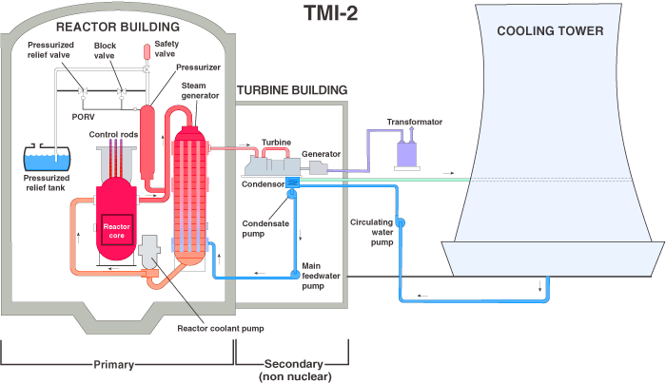
Management of Configuration during maintenance : TMI
Minor malfunction on the secondary side caused an increase in the primary coolant temperature and an automatic reactor shutdown was initiated
Because the emergency feedwater did not reach the steam generators quickly enough, the pressure increased in the primary circuit and a release valve opened on the pressurizer - as planned - but failed to close as it should have done after a few seconds
  The instrumentation available in the Main Control Room (MCR) did not reveal that fact
    Information in MCR showed that a “close” signal was sent to the valve by the control system but the information
    about the actual position
    of the valve was not
    reflected in the MCR
  Primary coolant was
  drained in the
  pressuriser relief tank
Notes:
It is common experience that over long periods of time, there is a gradual change in the properties of materials. These changes can affect the capability of engineered components, systems, or structures to perform their required function. Not all changes are deleterious, but it is commonly observed that ageing processes normally involve a gradual reduction in performance capability. All materials in a nuclear power plant can suffer from ageing and can partially or totally lose their designed function. Ageing is not only of concern for active components (for which the probability of malfunction increases with time) but also for passive ones, since the safety margin is being reduced towards the lowest allowable level.

Slide 56
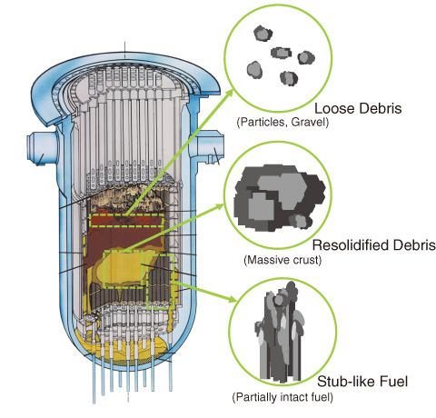
Management of Configuration during maintenance : TMI
High pressure injection pumps automatically started as a response to the loss of cooling water
  The level of water raised in the pressurizer
  To protect the integrity of the pressurizer, the operators reduced the flow of replacement water
Steam started forming in the primary circuit
The primary coolant pumps started vibrating
The operators shut down the pumps
This ended the forced cooling of the core.
Because of the continued leakage, the reactor
core was uncovered and the fuel rods were damaged
Superheated steam and gases blocked the injection flow
Later, the operators managed to restore cooling
A minor quantity of radioactive gases was released to the environment, without causing health effects
Notes:
It is common experience that over long periods of time, there is a gradual change in the properties of materials. These changes can affect the capability of engineered components, systems, or structures to perform their required function. Not all changes are deleterious, but it is commonly observed that ageing processes normally involve a gradual reduction in performance capability. All materials in a nuclear power plant can suffer from ageing and can partially or totally lose their designed function. Ageing is not only of concern for active components (for which the probability of malfunction increases with time) but also for passive ones, since the safety margin is being reduced towards the lowest allowable level.

Slide 57
Management of Configuration during maintenance : TMI
Why did the emergency feedwater not reach the steam generators quickly enough ?
  Because some valves had been closed during maintenance to test the emergency feedwater pumps
  These valves should have been opened again after the test
  But the operators forgot to re-open these valves after the test
  During the incident, it took 8 minutes to re-open the valves
  This was sufficient to
  initiate the first
  severe accident in the
  history of civil nuclear
  energy
Emergency feedwater tank
Emergency feedwater pump
Isolation valve not
re-opened after test
Back to slide n° 9
Notes:
It is common experience that over long periods of time, there is a gradual change in the properties of materials. These changes can affect the capability of engineered components, systems, or structures to perform their required function. Not all changes are deleterious, but it is commonly observed that ageing processes normally involve a gradual reduction in performance capability. All materials in a nuclear power plant can suffer from ageing and can partially or totally lose their designed function. Ageing is not only of concern for active components (for which the probability of malfunction increases with time) but also for passive ones, since the safety margin is being reduced towards the lowest allowable level.

Slide 58
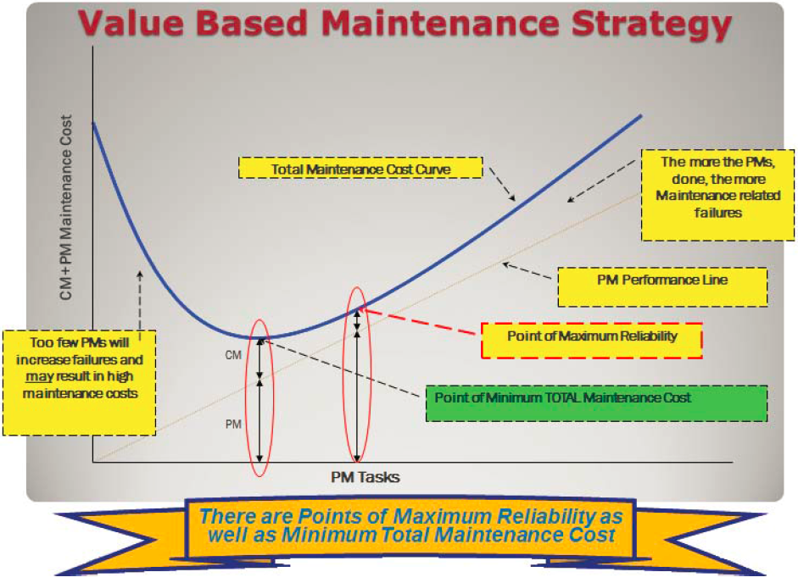
Innovative strategies for maintenance
Implemented in some
NPPs in USA
Reduction of unnecessary
maintenance activities
Claimed to improve safety
  Radiation safety (doses)
  Increased availability of
  ‘critical equipment’
Back to slide n° 22
Notes:
Value Based Maintenance (VBM), evaluates specifi c equipment failure modes, maintenance that can be applied to address those failure modes and risk in performing or not performing the maintenance.
Maintenance effectiveness, in terms of cost and expected equipment reliability,
is then measured with an expected economic value.
Implemented in Palo Verde
Dose reduced by 57%
Cost saving 10 M$ / year
EPRI is currently developing the infrastructure to autocollect data from the U.S. nuclear plants and provide a platform where the U.S. nuclear fl eet can share
data in an effort to continuously improve together.
The data collected will capture mistuned strategies, cost deviations and work histories across the industry.
The tool provides work history mapping, which helps defi ne equipment wear-out
times and improve mathematical models in preventive maintenance.

Slide 59
Case study
Reactor Scram and Safety Injection Caused by Human Errors during Maintenance Activities
Module XIII – Maintenance programme
June 18-22, 2018

Slide 60
Description of the event
While the plant was at full power, during a voltage test on a safety related battery and rectifier, a trainee technician misinterpreted a question from the lead technician and adjusted his multimeter to measure current.
The trainee then connected the multimeter to the rectifier terminals normally used for measuring voltage. This caused a loss of power to a safety-related switchboard.
This caused a short circuit.
resulted in an auto reactor scram, turbine trip, loss of 400kV supply from the step-down transformer, reactor coolant pump trips occurred.
June 18-22, 2018
Notes:
Since the first generation of commercial nuclear power plants started operating in the 1950s, there have been substantial developments in safety standards and practices, and in technology, resulting in new scientific and technical knowledge, better analytical methods and lessons learned from operating experience.
At the same time, for assessing the degree of plant conformity to those standards and practices, periodic safety reviews (PSR) are increasingly valuable.
Operational nuclear power plants in many states are subject to both routine and special safety reviews. It is a challenge to organize safety reviews that take into account improvements in safety standards and operating practices, modifications at the plant, the cumulative effects of plant ageing, feedback from operating experience, and possible developments in science and technology.
In many Member States worldwide, the PSR has been introduced as part of the regulatory system, and frequently runs on a 10-year cycle.
While every country through its regulatory body is free to choose its own safety review methodology, the minimum standards in the EU have to comply with the recommendations of the IAEA which are set out in the IAEA Specific Safety Guide SSG-25 Periodic Safety Review for Nuclear Power Plants.

Slide 61
Description of the event
Due to the short circuit, the normal power supply to the switchboard was lost.
Backup battery supply lost for an unknown reason.
A complete loss of power supply of the
safety-related 48 VDC switchboard resulted
This caused the following:
  Automatic reactor scram and turbine trip
  Opening of the step-down transformer circuit breakers
  Loss of 400 kV supply from the step-down transformer
  Loss of normal pressuriser spray
  Loss of the CVCS let-down
June 18-22, 2018
Notes:
Since the first generation of commercial nuclear power plants started operating in the 1950s, there have been substantial developments in safety standards and practices, and in technology, resulting in new scientific and technical knowledge, better analytical methods and lessons learned from operating experience.
At the same time, for assessing the degree of plant conformity to those standards and practices, periodic safety reviews (PSR) are increasingly valuable.
Operational nuclear power plants in many states are subject to both routine and special safety reviews. It is a challenge to organize safety reviews that take into account improvements in safety standards and operating practices, modifications at the plant, the cumulative effects of plant ageing, feedback from operating experience, and possible developments in science and technology.
In many Member States worldwide, the PSR has been introduced as part of the regulatory system, and frequently runs on a 10-year cycle.
While every country through its regulatory body is free to choose its own safety review methodology, the minimum standards in the EU have to comply with the recommendations of the IAEA which are set out in the IAEA Specific Safety Guide SSG-25 Periodic Safety Review for Nuclear Power Plants.

Slide 62
Description of the event
Without communicating with the control room, the maintenance team restored power: They were not aware that the reactor had scrammed and that this action would actuate safety injection.
A posted warning sign on local panel was not noticed.
The primary pressure increased, and a pressuriser relief valve opened 40 times. One of the two diaphragms on the pressuriser relief tank ruptured.
A 12-day unplanned outage was required to investigate the event and complete repairs.
June 18-22, 2018
Notes:
Since the first generation of commercial nuclear power plants started operating in the 1950s, there have been substantial developments in safety standards and practices, and in technology, resulting in new scientific and technical knowledge, better analytical methods and lessons learned from operating experience.
At the same time, for assessing the degree of plant conformity to those standards and practices, periodic safety reviews (PSR) are increasingly valuable.
Operational nuclear power plants in many states are subject to both routine and special safety reviews. It is a challenge to organize safety reviews that take into account improvements in safety standards and operating practices, modifications at the plant, the cumulative effects of plant ageing, feedback from operating experience, and possible developments in science and technology.
In many Member States worldwide, the PSR has been introduced as part of the regulatory system, and frequently runs on a 10-year cycle.
While every country through its regulatory body is free to choose its own safety review methodology, the minimum standards in the EU have to comply with the recommendations of the IAEA which are set out in the IAEA Specific Safety Guide SSG-25 Periodic Safety Review for Nuclear Power Plants.

Slide 63
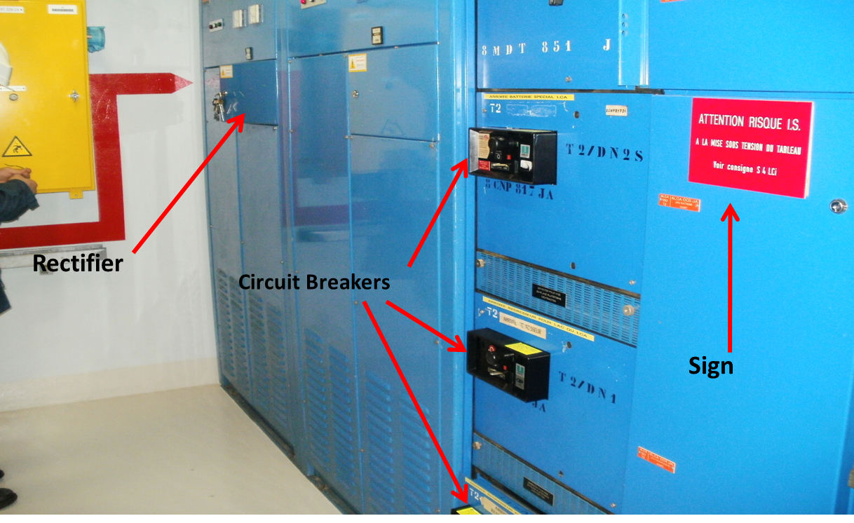
Description of the event
  The posted warning sign on local panel about the risk of safety injection was not noticed
June 18-22, 2018
Notes:
Since the first generation of commercial nuclear power plants started operating in the 1950s, there have been substantial developments in safety standards and practices, and in technology, resulting in new scientific and technical knowledge, better analytical methods and lessons learned from operating experience.
At the same time, for assessing the degree of plant conformity to those standards and practices, periodic safety reviews (PSR) are increasingly valuable.
Operational nuclear power plants in many states are subject to both routine and special safety reviews. It is a challenge to organize safety reviews that take into account improvements in safety standards and operating practices, modifications at the plant, the cumulative effects of plant ageing, feedback from operating experience, and possible developments in science and technology.
In many Member States worldwide, the PSR has been introduced as part of the regulatory system, and frequently runs on a 10-year cycle.
While every country through its regulatory body is free to choose its own safety review methodology, the minimum standards in the EU have to comply with the recommendations of the IAEA which are set out in the IAEA Specific Safety Guide SSG-25 Periodic Safety Review for Nuclear Power Plants.

Slide 64
Event Causes
Lack of risk assessment
Distracting environment
Human Error Prevention Tool not used
Weaknesses in Nuclear Safety Culture
  Not using HU error reduction tools
  Acting outside of normal role (operating equipment in recovery attempt without approval of operators)
  Lack of situational awareness
  Insufficient questioning attitude
Operating Experience
  Several similar fleet events
  No common cause review
June 18-22, 2018
Notes:
Lack of Risk Assessment
The test was conceived as low risk
No pre-job briefing and contingency plan
Deviating from procedure
Performing voltage measurement in wrong location
Posted warning sign on local panel not noticed
Distracting Environment
Four people (two extra attendees)
Shadow training conducted as part of the testing
Unclear roles and responsibilities of lead technician, workers and trainees
Human Error Prevention Tools NOT Used
No pre-job brief
Procedure adherence
Three-way communication
Peer verification
Self-checking
Timeout when unsure

Slide 65
Lessons Learned
Reinforce compliance with maintenance procedures. Rigorous and timely methods for procedure revision including risk assessment for change requests should be in place.
Define clearly role and responsibility of maintenance workers, lead technicians and supervisors.
Systematically use human performance error reduction tools during maintenance work.
June 18-22, 2018

Slide 66
Lessons Learned
Take timeouts when facing unexpected situation before taking any action.
Enhance safety culture as one part of the maintenance fundamentals in a continuous way for an effective line of defence.
Review the risk of electrical work on safety-related power supplies.
During risk assessment, consider potential human errors.
June 18-22, 2018

Slide 67
Lessons Learned
Make sure work supervisor and line manager have sufficient knowledge of operational risk of the component and system they work on.
Review and reinforce more rigorous evaluation of industry and fleet operating experience for applicability.
June 18-22, 2018

Slide 68
Prevent Events
    Maintenance
Are managers and supervisors setting the standard and providing a role model by demonstrating traits of a healthy nuclear safety culture and reinforcing the use of human error reduction tools?
Are procedures accurate for the job and can they easily be followed? Are the risks assessed rigorously and factored into the procedure?
Are risk assessments, human performance tools, operating experience addressed during pre-job briefings?
Do workers understand when they can or cannot operate equipment based on the work authorisation from operations?
June 18-22, 2018

Slide 69
Prevent Events
    Planning Personnel
      When planning maintenance work, do personnel understand the risks and how to minimise consequence from unexpected equipment problems?
      Have error-prone situations been considered ?
      Do cautions in work documents clearly describe the potential of a loss of safety-related power supply or other significant consequential outcomes?
      How is it ensured that applicable operating experience is reviewed and applied to potential work activities?
June 18-22, 2018

Slide 70
Prevent Events
    Line Manager
      Are workers assigned to the tasks qualified and proficient to complete the work properly?
      Are workers receiving nuclear safety culture training tailored to their specific maintenance activities?
      Is sufficient oversight given to the field work to identify noncompliance in procedure adherence?
      Are risks considered beforehand to manage influences of on-the-job training?
June 18-22, 2018

Slide 71
Why is this event important ?
      The risk assessment and worker’s risk awareness was not adequate for the work on safety related power supply system.
      Not adhering to the procedure was a common practice, increasing probability of a human error. Knowingly not adhering to procedures is an indication of degraded safety culture.
      Distraction was not considered and managed as a risk while composing work team and planning on the job training.
      A pre-job briefing was not conducted, which could have been instrumental for the newcomer and also may have prevented the event.
June 18-22, 2018

Slide 72
Why is this event important ?
A complicated event resulted from human errors that demonstrated weaknesses in nuclear safety culture. Operators were unaware why abnormal events were occurring.
Impulsive non-validated actions were taken without considering the possible consequences before attempting corrective actions to re-energise the switchboard.
June 18-22, 2018

Slide 73
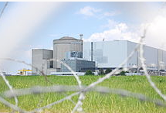
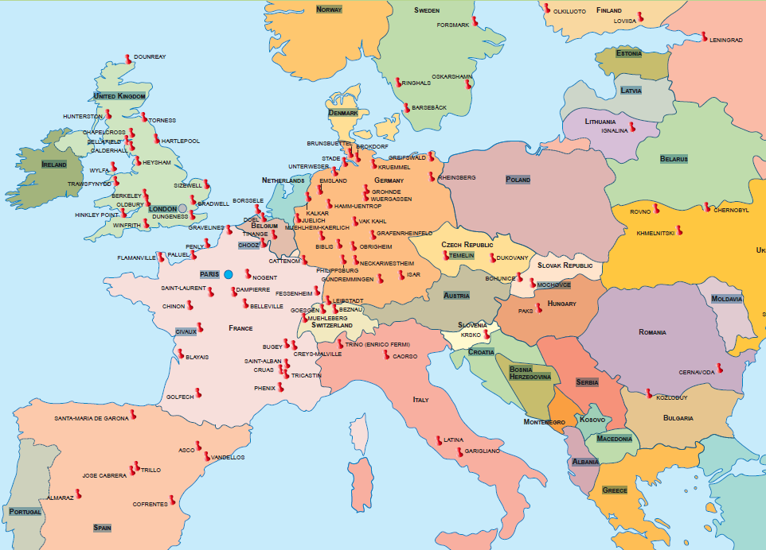
This incident at Blayais 2014 was shared by the operator EDF with other operators worldwide
While this event occurred at a pressurised reactor, the lessons learned are applicable for preventing maintenance related events at any type of reactor.
This event highlights the importance of a healthy nuclear safety culture at all levels of plant workers and the need for rigourous and consistent use of human error reduction tools.
Back to slide n° 24
June 18-22, 2018

